Slide 1
ANALYZING Motion pictures data USING SQL -A DATA ANALYST’S PERSPECTIVE
UNDER THE GUIDANCE OF Munna Pandey SIR
BY
` SHAIK AAYESHA MOHAMMADI

Slide 2
TABLE OF CONTENTS
ABSTRACT
EACH TASKS , THEIR DESCRIPTION & OUTPUTS
ADVANTAGES
DISADVANTAGES
APPLICATIONS
CONCLUSION

Slide 3
ABSTRACT
This analysis will help Sakila Movie Rental Store to understand what types of movies and actors are most popular among their customers.
By analyzing rental data, we can identify patterns and trends that will help improve inventory management and ultimately, business success,helps us to make informed decisions to improve their business.

Slide 4
TASK 1 : Display the first_names, last_names , actor_id, last_updated Column
The SQL query "SELECT * FROM actor" retrieves all the data from the "actor" table in the Sakila database
Step 1: "SELECT" is the keyword used to retrieve data from a table.
Step 2: "*" is a wildcard character that specifies that all columns in the table should be retrieved.
Step 3: "FROM" is the keyword used to specify the table from which to retrieve data.
Step 4 : "actor" is the name of the table from which to retrieve data.
The query retrieves all the data from the "actor" table in the Sakila database and displays it in a table format.

Slide 5
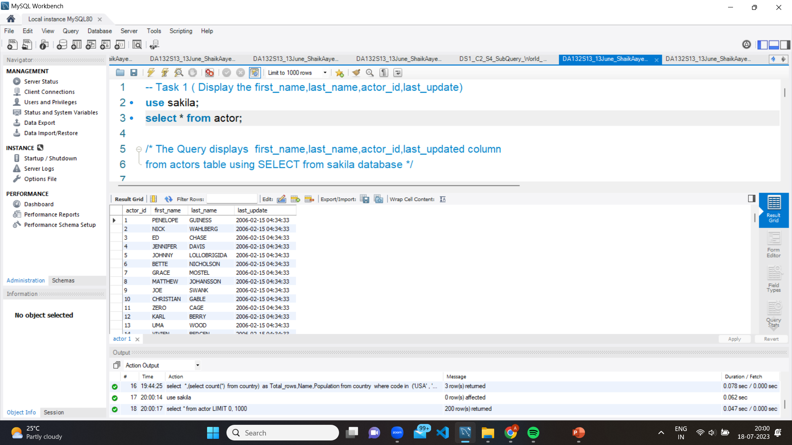
Output of TASK 1

Slide 6
Task 2 (a) Display the full names of all actors
The SQL query "SELECT concat(first_name,' ',last_name)as 'Employee Full Name FROM actor" retrieves all the data from the "actor" table in the Sakila database.
STEP 1: SELECT: This is a keyword used to select data from a table.
STEP 2 : CONCAT: This is a function used to concatenate two or more strings together. In this case, it is used to concatenate the first name and last name of each actor.
STEP 3 : first_name: This is the name of the column in the 'actor' table that contains the first name of each actor.
STEP 4 : last_name: This is the name of the column in the 'actor' table that contains the last name of each actor.
STEP 5: FROM: This is a keyword used to specify the table from which we want to select data.
STEP 6: actor: This is the name of the table from which we want to select data.
The Query returns a list of full names for all actors in the 'actor' table, with a space separating the first and last names.

Slide 7
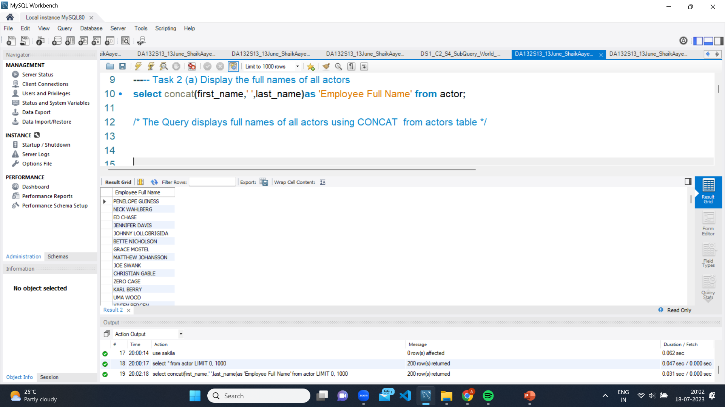
Output of TASK 2(a)

Slide 8
Task 2(b) Display the first_names of actors along with count of repeated first_names
The SQL query "SELECT first_name,count(first_name) as Count_of_Firstnames from actor group by first_name having count(first_name)>1 “
STEP 1. SELECT: This is a keyword used to select data from a table.
STEP 2. first_name: This is the name of the column in the actor table that contains the first name of each actor.
STEP 3. COUNT: This is an aggregate function that counts the number of times a value appears in a column.
STEP 4. AS: This is a keyword used to alias the column name to a more descriptive name.
STEP 5. Count_of_Firstnames: This is the new column name that is created by aliasing the count result.
STEP 6. FROM: This is a keyword used to specify the table from which we want to select data.
STEP 7. actor: This is the name of the table from which we want to select data.
STEP 8. GROUP BY: This is a keyword used to group the results based on a column.
STEP 9. first_name: This is the column name used to group the results.
STEP 10. HAVING: This is a keyword used to filter the results based on a condition.
STEP 11. count(first_name)>1: This is the condition used to filter the results to only include first names that appear more than once.
The result returns a list of first names from the actor table along with the count of how many times each first name appears in the table. The results would be grouped by first name and would only include first names that appear more than once.

Slide 9
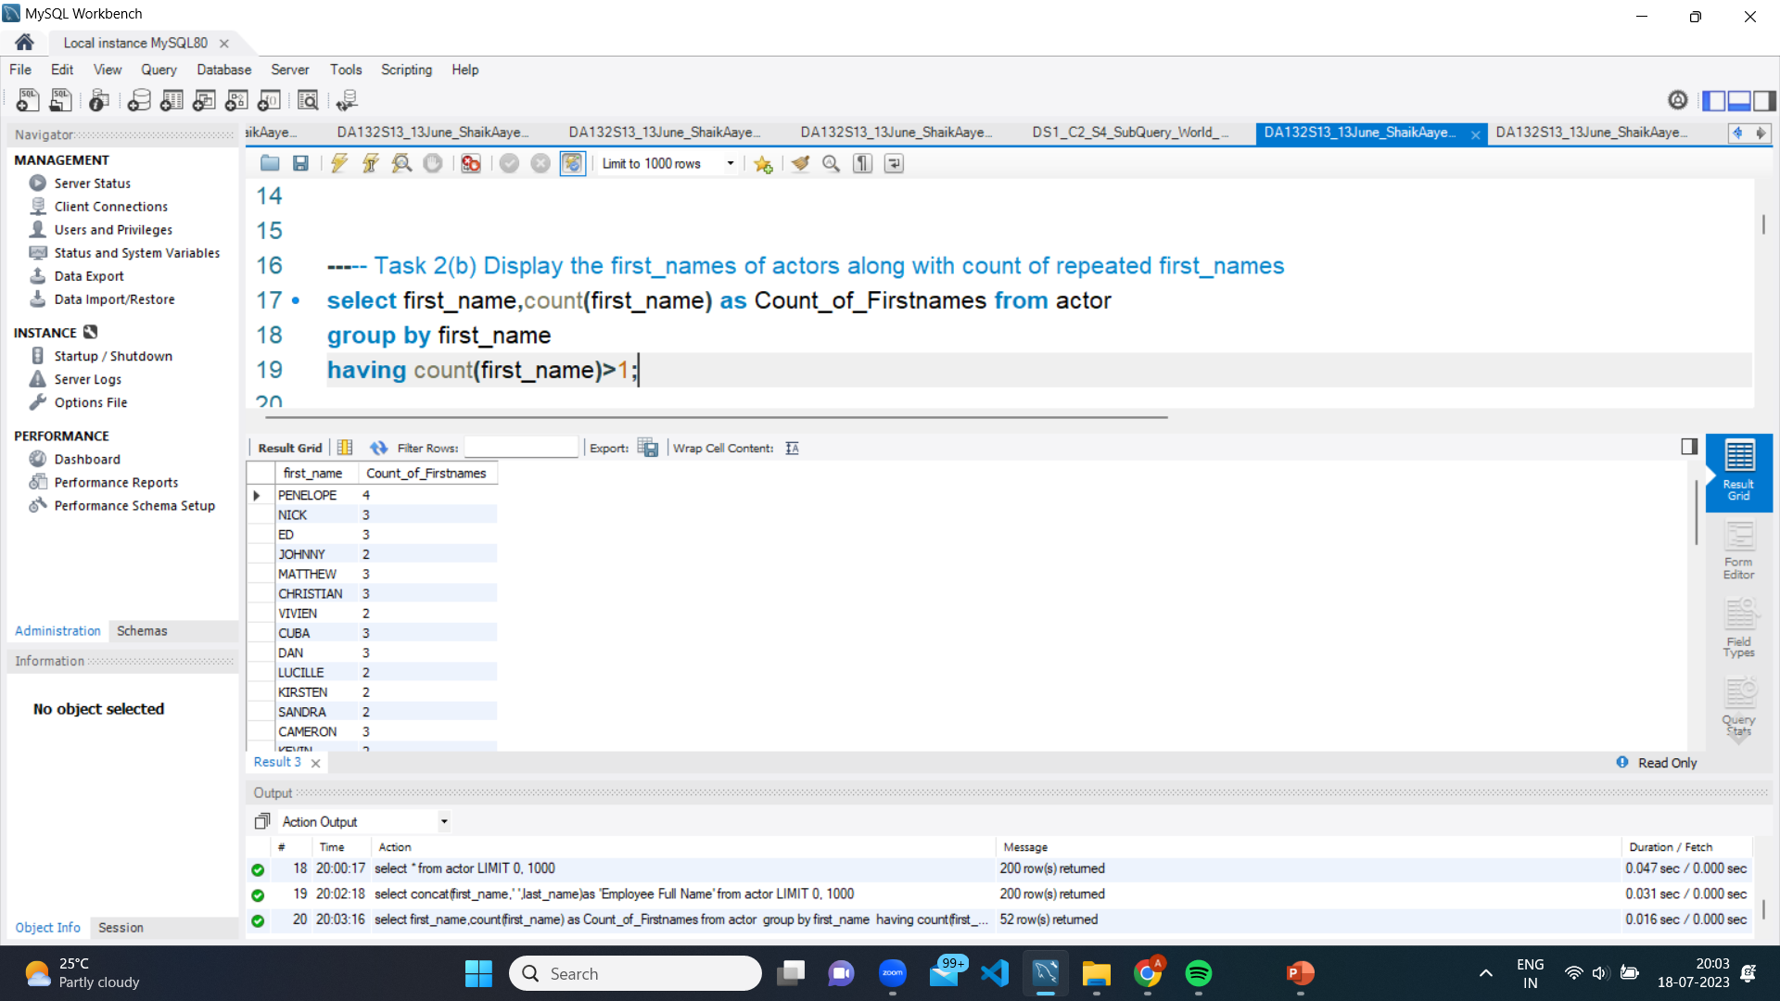
Output of TASK 2(B)

Slide 10
Task 2(c) Display the last_names of actors along with count of repeated last_names
The SQL query " select last_name,count(last_name) as Count_of_Lastnames from actor group by last_name having count(last_name)>1 “
STEP 1. SELECT: This is a keyword used to select data from a table.
STEP 2.Last_name: This is the name of the column in the actor table that contains the first name of each actor.
STEP 3. COUNT: This is an aggregate function that counts the number of times a value appears in a column.
STEP 4. AS: This is a keyword used to alias the column name to a more descriptive name.
STEP 5. Count_of_Lastnames: This is the new column name that is created by aliasing the count result.
STEP 6. FROM: This is a keyword used to specify the table from which we want to select data.
STEP 7. actor: This is the name of the table from which we want to select data.
STEP 8. GROUP BY: This is a keyword used to group the results based on a column.
STEP 9. Last_name: This is the column name used to group the results.
STEP 10. HAVING: This is a keyword used to filter the results based on a condition.
STEP 11. count(last_name)>1: This is the condition used to filter the results to only include first names that appear more than once.
The Query returns a list of last names from the actor table along with the count of how many times each LAST name appears in the table. The results would be grouped by last name and would only include last names that appear more than once.

Slide 11
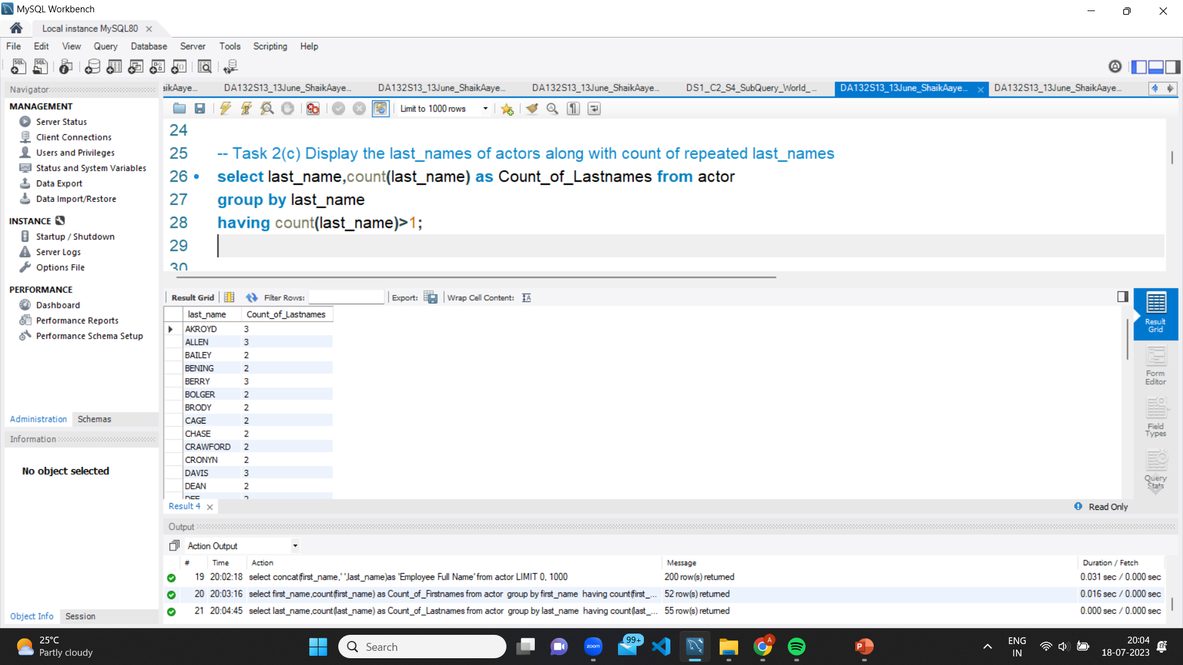
Output of TASK 2(c)

Slide 12
Task 3 Display the count of movies group by ratings
The Query " select rating ,count (*) as count from film group by rating “
STEP 1. SELECT: This is a keyword used to select data from a table.
STEP 2. rating: This is the name of the column in the film table that contains the rating of each film.
STEP 3. COUNT: This is an aggregate function that counts the number of times a value appears in a column.
STEP 4. *: This is a wildcard character that specifies all columns in the film table.
STEP 5. AS: This is a keyword used to alias the column name to a more descriptive name.
STEP 6. count: This is the new c olumn name that is created by aliasing the count result.
STEP 7. FROM: This is a keyword used to specify the table from which we want to select data.
STEP 8. film: This is the name of the table from which we want to select data.
STEP 9. GROUP BY: This is a keyword used to group the results based on a column.
STEP 10. rating: This is the column name used to group the results.
The query would return a list of ratings from the film table along with the count of how many times each rating appears in the table. The results would be grouped by rating.

Slide 13
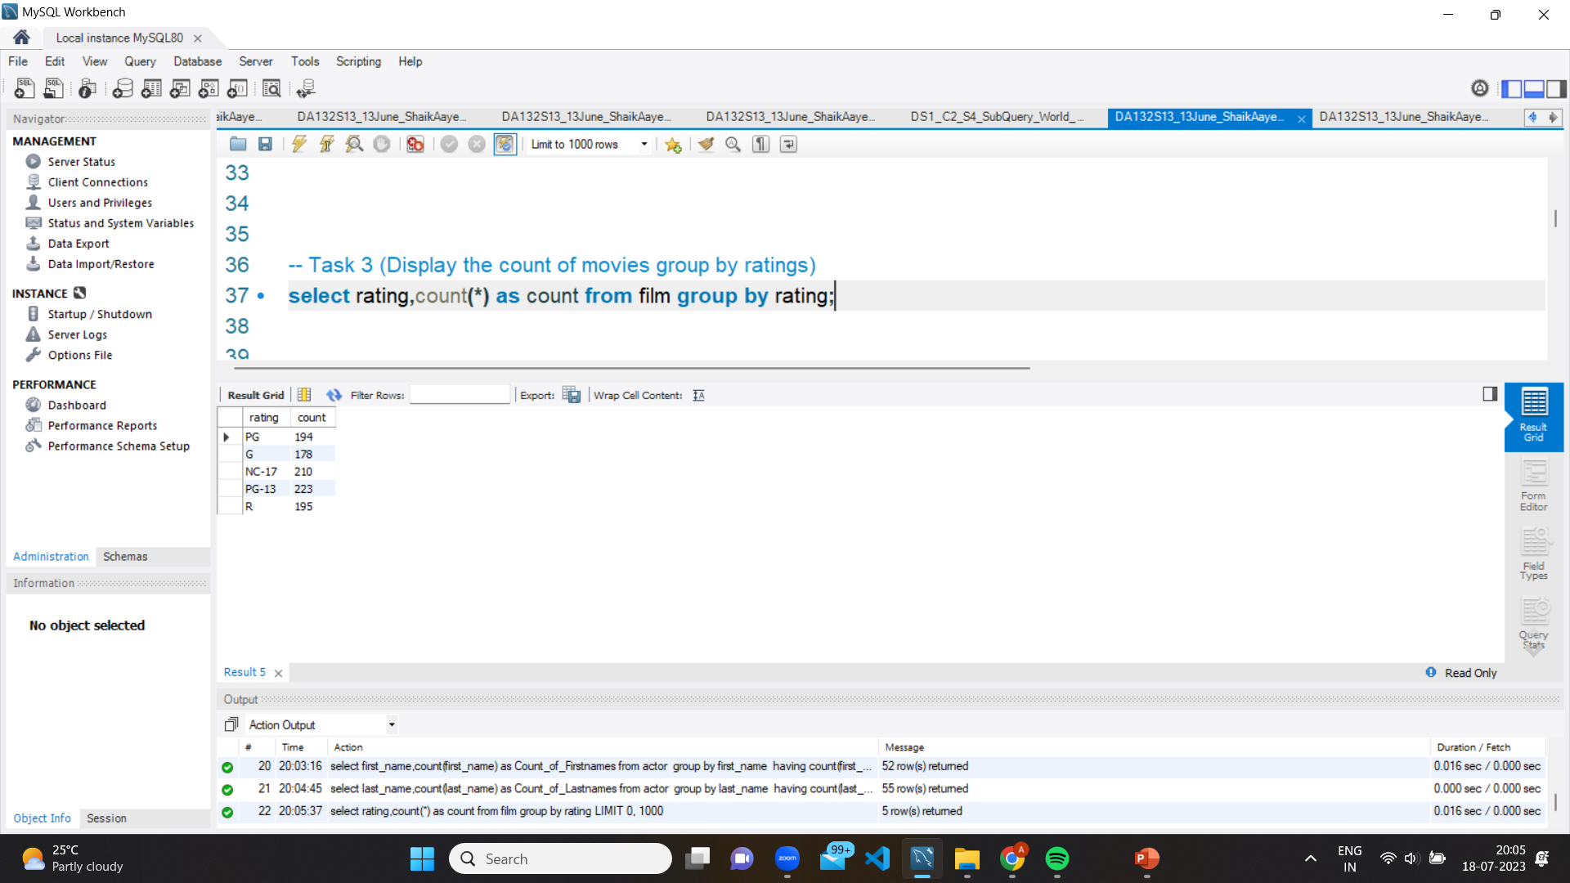
Output of TASK 3
Output of TASK 2(c)

Slide 14
Task 4 (Display the average rental rates based on ratings)
The Query " select rating,avg(rental_rate) as Avg_of_rental_rate from film group by 1 “
STEP 1. SELECT: This is a keyword used to select data from a table.
STEP 2. rating: This is the name of the column in the film table that contains the rating of each film.
STEP 3. AVG: This is an aggregate function that calculates the average value of a column.
STEP 4. rental_rate: This is the name of the column in the film table that contains the rental rate of each film.
STEP 5. AS: This is a keyword used to alias the column name to a more descriptive name.
STEP 6. Avg_of_rental_rate: This is the new column name that is created by aliasing the average rental rate result.
STEP 7. FROM: This is a keyword used to specify the table from which we want to select data.
STEP 8. film: This is the name of the table from which we want to select data.
STEP 9. GROUP BY: This is a keyword used to group the results based on a column.
STEP 10. This is shorthand for the first column selected in the SELECT clause, which is the rating column.
The Query returns a list of ratings from the film table along with the average rental rate for each rating. The results would be grouped by rating.

Slide 15
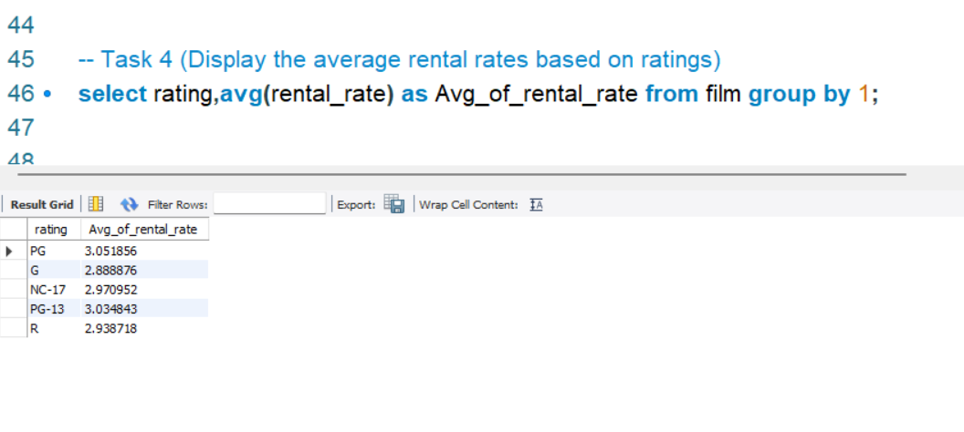
Output of TASK 4

Slide 16
Task 5 (a) Display the movie titles where replacement_cost is up to $9
The Query " select title as Movie_Titles,replacement_cost from film where replacement_cost between 0 and 9"
STEP 1. SELECT: This is a keyword used to select data from a table.
STEP 2. title: This is the name of the column in the film table that contains the title of each film.
STEP 3. AS: This is a keyword used to alias the column name to a more descriptive name.
STEP 4. Movie_Titles: This is the new column name that is created by aliasing the title column.’
STEP 5. replacement_cost: This is the name of the column in the film table that contains the replacement cost of each film.
STEP 6. FROM: This is a keyword used to specify the table from which we want to select data.
STEP 7. film: This is the name of the table from which we want to select data.
STEP 8. WHERE: This is a keyword used to filter the results based on a condition.
STEP 9. replacement_cost BETWEEN 0 AND 9: This is the condition used to filter the results to only include films where the replacement cost falls between 0 and 9.
The Query returns a list of movie titles and their replacement cost from the film table, but only for films where the replacement cost falls between 0 and 9.

Slide 17
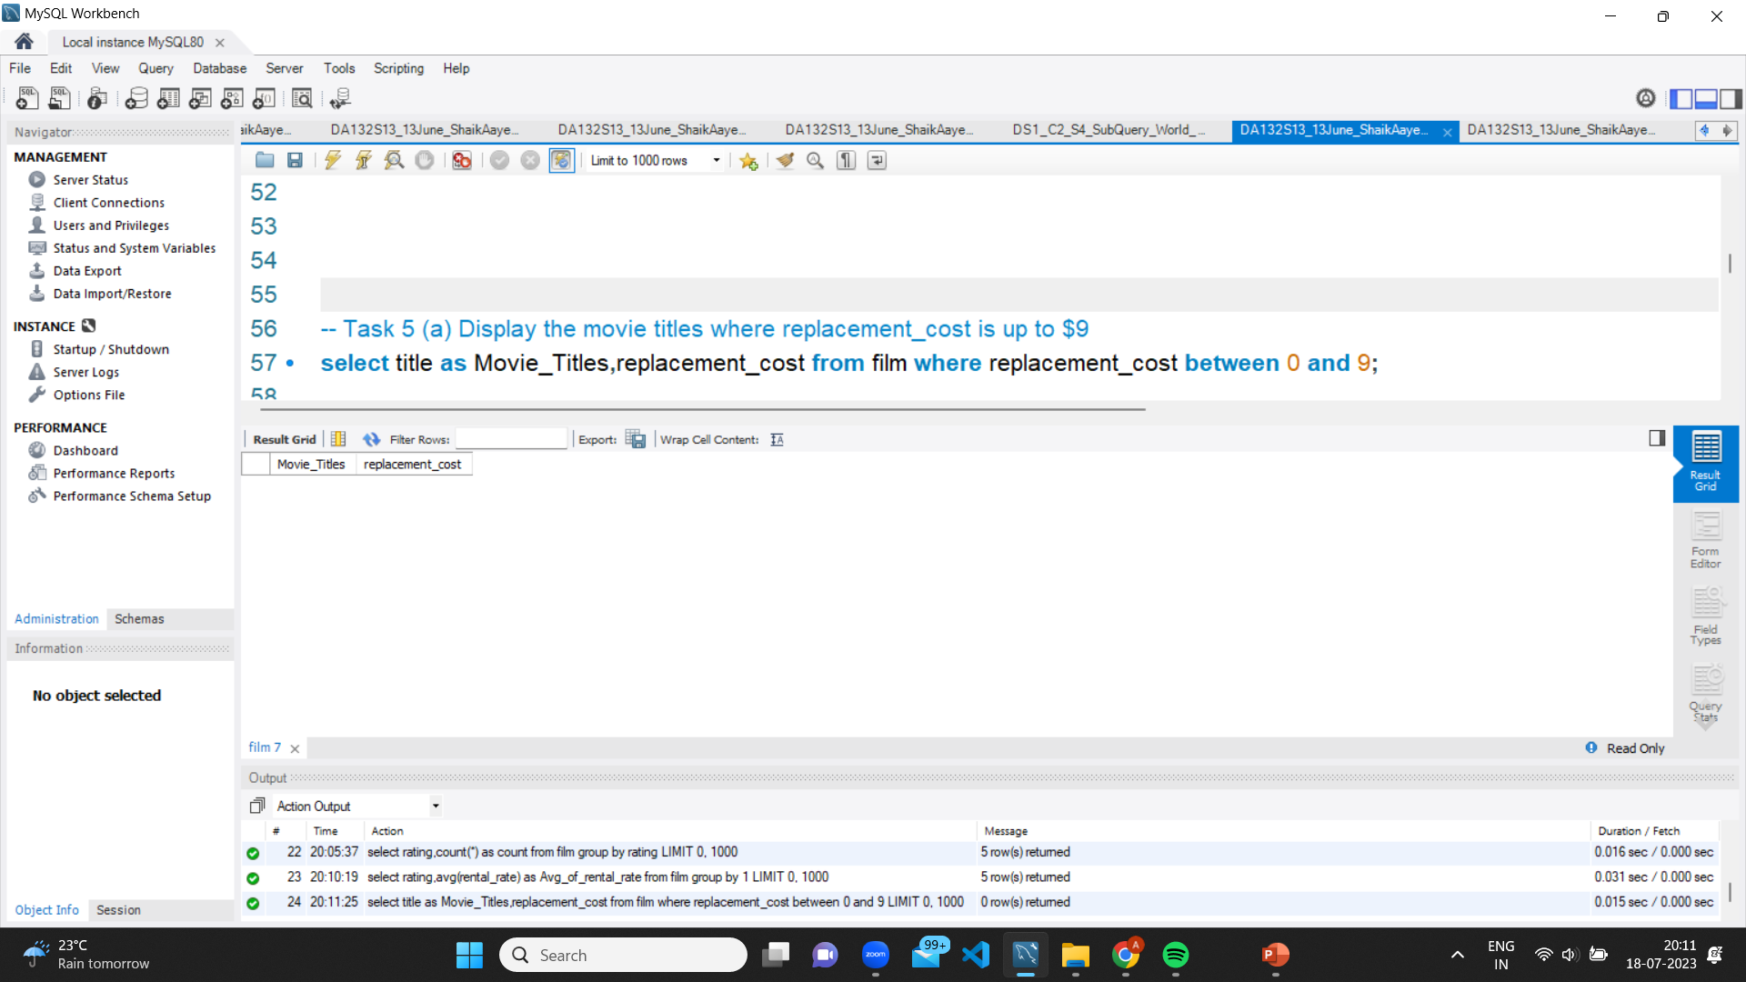
Output of TASK 5(a)

Slide 18
Task 5 (b) Display the movie titles where replacement_cost between 15 and 20
The Query " select title as Movie_Titles,replacement_cost from film where replacement_cost between 15 and 20 “
STEP 1. SELECT: This is a keyword used to select data from a table.
STEP 2. title: This is the name of the column in the film table that contains the title of each film.
STEP 3. AS: This is a keyword used to alias the column name to a more descriptive name.
STEP 4. Movie_Titles: This is the new column name that is created by aliasing the title column.
STEP 5. replacement_cost: This is the name of the column in the film table that contains the replacement cost of each film.
STEP 6. FROM: This is a keyword used to specify the table from which we want to select data.
STEP 7. film: This is the name of the table from which we want to select data.
STEP 8. WHERE: This is a keyword used to filter the results based on a condition.
STEP 9. replacement_cost BETWEEN 15 AND 20: This is the condition used to filter the results to only include films where the replacement cost falls between 15 and 20.
The Query returns a list of movie titles and their replacement cost from the film table, but only for films where the replacement cost falls between 15 and 20

Slide 19
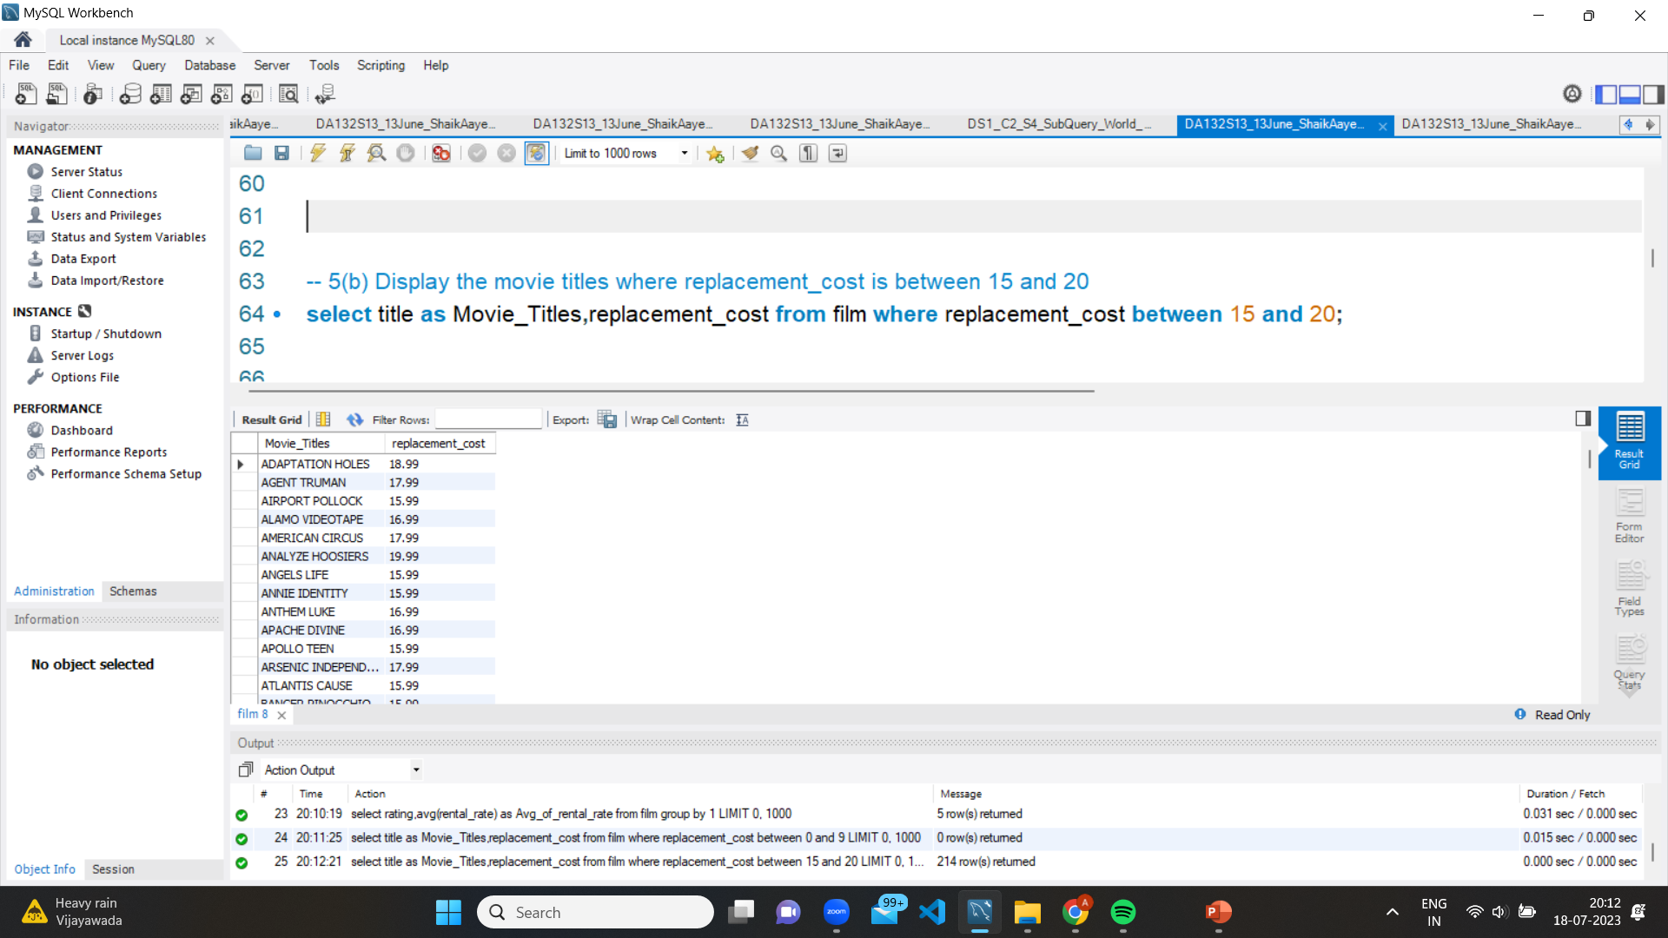
Output of TASK 5(b)

Slide 20
5(c)Display the movie titles with highest replacement_cost and lowest rental cost
The Query " select film.title as Movie_Titles,max(replacement_cost) as MAX_replacement_cost,min(film.rental_rate * film.rental_duration) as Min_rental_cost from filmgroup by 1 order by 2 desc,3 asc " ;
STEP 1. SELECT: This is a keyword used to select data from a table.
STEP 2. film.title: This is the name of the column in the film table that contains the title of each film.
STEP 3. AS: This is a keyword used to alias the column name to a more descriptive name.
STEP 4. Movie_Titles: This is the new column name that is created by aliasing the title column.
STEP 5. MAX: This is a function used to return the maximum value of the specified column.
STEP 6. replacement_cost: This is the name of the column in the film table that contains the replacement cost of each film.
STEP 7. min: This is a function used to return the minimum value of the result of multiplying the rental_rate column by the rental_duration column.
STEP 8. film.rental_rate: This is the name of the column in the film table that contains the rental rate of each film.
STEP 9. film.rental_duration: This is the name of the column in the film table that contains the rental duration of each film.

Slide 21
STEP 10. FROM: This is a keyword used to specify the table from which we want to select data.
STEP 11. film: This is the name of the table from which we want to select data.
STEP 12. GROUP BY: This is a keyword used to group the results by a specified column.
STEP 13. 1: This refers to the first column specified in the SELECT statement, which is the title column.
STEP 14. ORDER BY: This is a keyword used to order the results by one or more columns.
STEP 15. 2: This refers to the second column specified in the SELECT statement, which is the MAX_replacement_cost column.
STEP 16. DESC: This is a keyword used to order the results in descending order.
STEP 17. 3: This refers to the third column specified in the SELECT statement, which is the Min_rental_cost column.
STEP 18. ASC: This is a keyword used to order the results

Slide 22
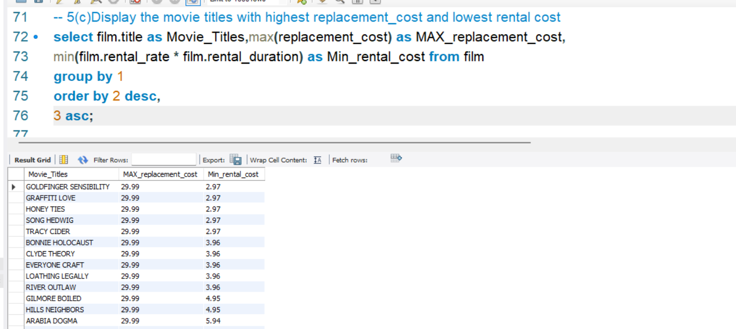
Output of TASK 5(c)

Slide 23
Task 6 Display the list all the movies along with number of actors listed from each movie
The Query " select f.title as Movie_Titles,count(*) as Number_of_actors from film f inner join film_actor fc on f.film_id=fc.film_id group by f.title ";
STEP 1- `SELECT f.title AS Movie_Titles, COUNT(*) AS Number_of_actors`: This selects the `title` column from the `film` table and aliases it as `Movie_Titles`. It also counts the number of rows in the result set and aliases it as `Number_of_actors`.
STEP 2 - `FROM film f`: This specifies the `film` table and aliases it as `f`.
STEP 3 - `INNER JOIN film_actor fc ON f.film_id = fc.film_id`: This joins the `film` table with the `film_actor` table on the `film_id` column.
STEP 4 - `GROUP BY f.title`: This groups the results by movie title, which is specified by the `title` column in the `film` table.
Overall, this query will return a list of movie titles and the number of actors in each movie.

Slide 24
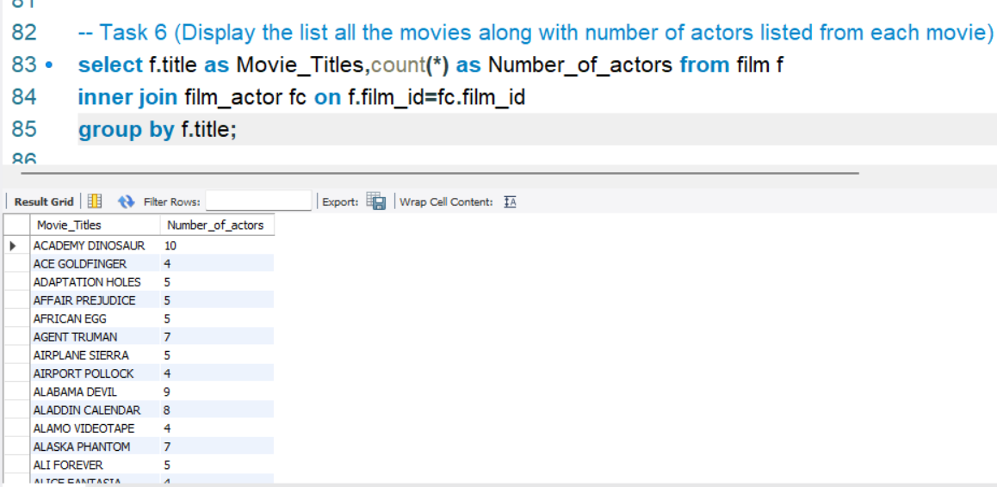
Output of TASK 6

Slide 25
Task 7 Display the movie titles starting with letters K and Q
The Query " select title as Movies from film where title like 'k%' or title like 'q% “
STEP 1 - `SELECT title AS Movies`: This selects the `title` column from the `film` table and aliases it as `Movies`.
STEP 2- `FROM film`: This specifies the `film` table.
STEP 3- `WHERE title LIKE 'k%' OR title LIKE 'q%'`: This filters the results to only include movies whose title starts with "k" or "q". The `LIKE` operator is used to match patterns in the `title` column. The `%` symbol is a wildcard that matches any number of characters. So, `LIKE 'k%'` matches any title that starts with the letter "k", and `LIKE 'q%'` matches any title that starts with the letter "q".
Overall, this query will return a list of movies whose title starts with "k" or "q".

Slide 26
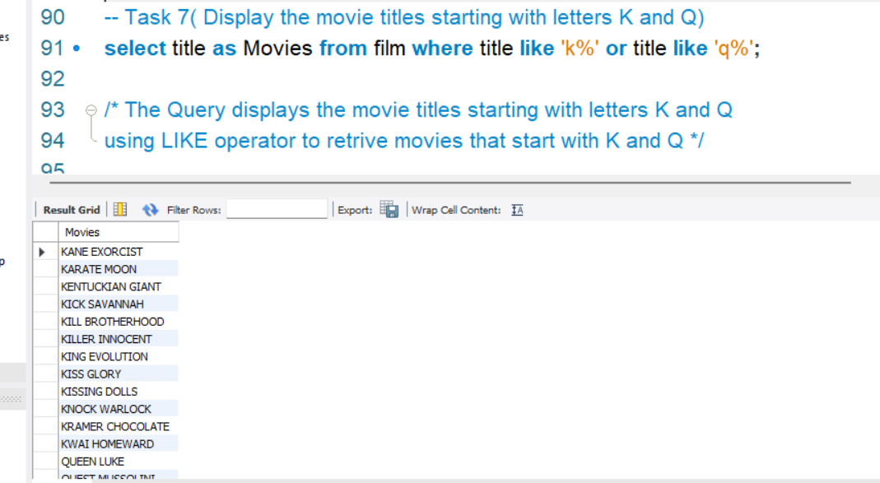
Output of TASK 7

Slide 27
Task 8 ( Display first_name and last_name of all actors who acted in 'AGENT TRUMAN' movie)
The Query " select actor.first_name,actor.last_name from actor join film_actor using (actor_id) join film using (film_id) where title = 'AGENT TRUMAN’ “
STEP 1- `SELECT actor.first_name, actor.last_name`: This selects the `first_name` and `last_name` columns from the `actor` table.
STEP 2- `FROM actor`: This specifies the `actor` table.
STEP 3- `JOIN film_actor USING (actor_id)`: This joins the `actor` table with the `film_actor` table on the `actor_id` column.
STEP 4- `JOIN film USING (film_id)`: This joins the `film_actor` table with the `film` table on the `film_id` column.
STEP 5- `WHERE title = 'AGENT TRUMAN'`: This filters the results to only include actors who acted in the movie "AGENT TRUMAN". The `WHERE` clause specifies the condition that the `title` column in the `film` table must equal "AGENT TRUMAN".
Overall, this query will return a list of actors who acted in the movie "AGENT TRUMAN".

Slide 28
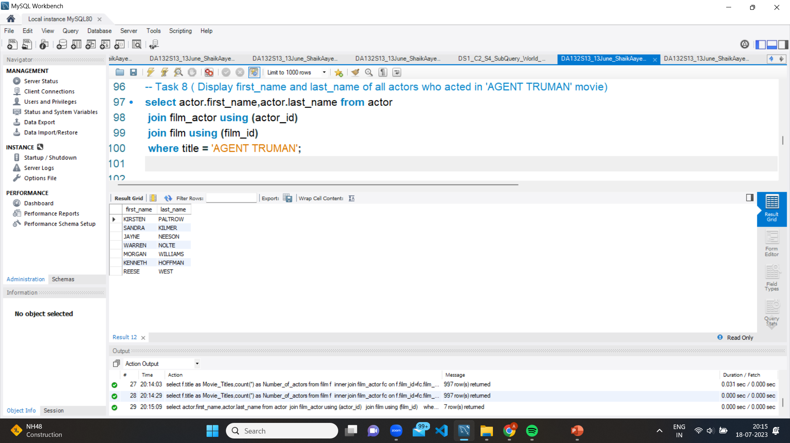
Output of TASK 8

Slide 29
Task 9 Identify and Display the names of the movies in the family and children category
The Query " select film.title as 'Children & Family Movies' from film join film_category using (film_id )join category using (category_id)where category.name in ('children','family’) “
STEP 1- `SELECT film.title AS 'Children & Family Movies'`: This selects the `title` column from the `film` table and aliases it as `'Children & Family Movies’`.
STEP 2- `FROM film`: This specifies the `film` table.
STEP 3- `JOIN film_category USING (film_id)`: This joins the `film` table with the `film_category` table on the `film_id` column.
STEP 4- `JOIN category USING (category_id)`: This joins the `film_category` table with the `category` table on the `category_id` column.
STEP 5 - `WHERE category.name IN ('children', 'family')`: This filters the results to only include movies that are categorized as either "children" or "family". The `WHERE` clause specifies the condition that the `name` column in the `category` table must be either "children" or "family".
Overall, this query will return a list of movies that are categorized as either "children" or "family", and will alias the `title` column as `'Children & Family Movies'`.

Slide 30
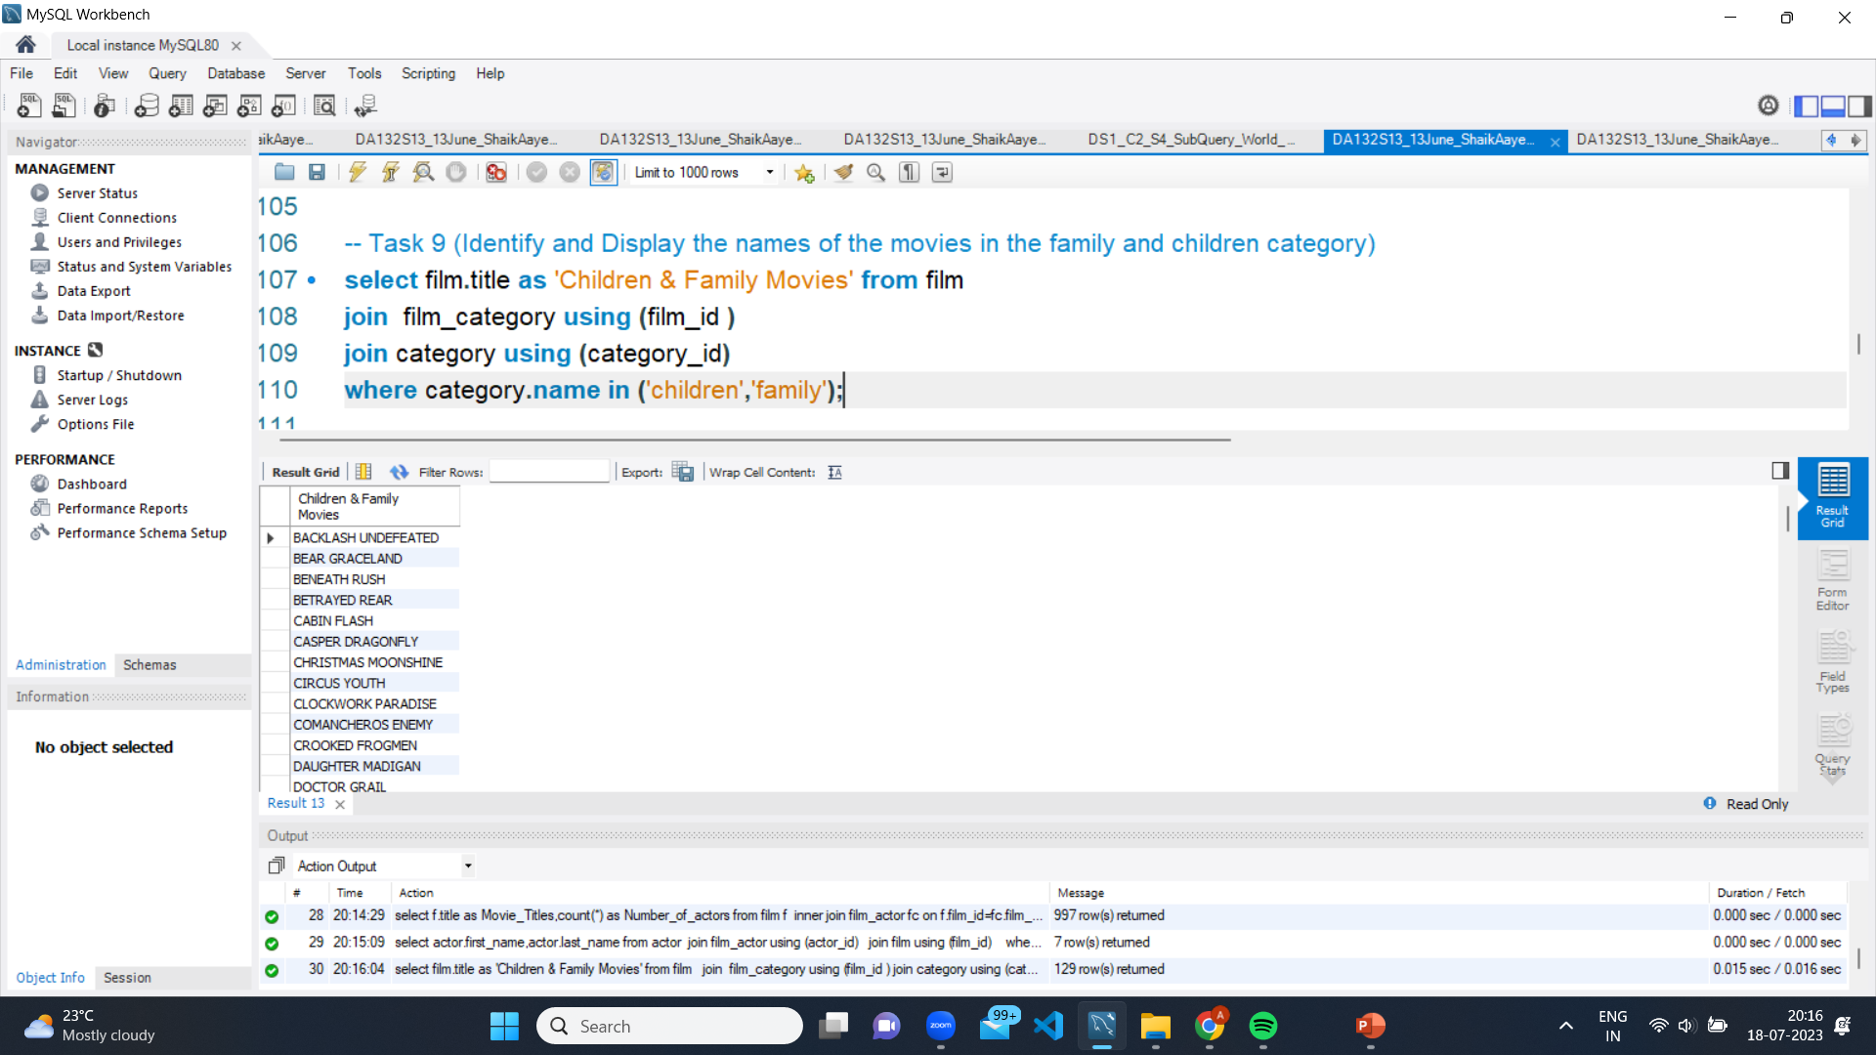
Output of TASK 9

Slide 31
Task 10 (Display the names of most frequently rented movies in descending order)
The Query " select film.title as Movie_Names,count(rental.rental_id) as Rental_count from film join inventory using (film_id) join rental using (inventory_id) group by 1 order by 2 desc “
STEP 1- `SELECT film.title AS Movie_Names, COUNT(rental.rental_id) AS Rental_count`: This selects the `title` column from the `film` table and aliases it as `Movie_Names`. It also counts the number of times each movie has been rented and aliases it as `Rental_count`.
STEP 2- `FROM film`: This specifies the `film` table.
STEP 3- `JOIN inventory USING (film_id)`: This joins the `film` table with the `inventory` table on the `film_id` column.
STEP 4- `JOIN rental USING (inventory_id)`: This joins the `inventory` table with the `rental` table on the `inventory_id` column.
STEP 5- `GROUP BY 1`: This groups the results by the `Movie_Names` column.
STEP 6 - `ORDER BY 2 DESC`: This orders the results in descending order by the `Rental_count` column.
Overall, this query will return a list of movies with their respective rental counts, ordered by the number of rentals in descending order.

Slide 32
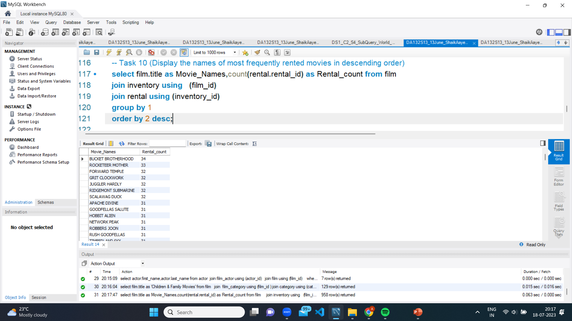
Output of TASK 10

Slide 33
Task 11 Display the number of movie categories where average difference between movie replacement_cost and rental_rate is greater than 15
create view category_avg_diff asselect category.name, AVG(film.replacement_cost - film.rental_rate) as avg_difffrom categoryjoin film_category on category.category_id = film_category.category_idjoin film on film_category.film_id = film.film_idgroup by category.name;
STEP 1:This view calculates the average difference between the replacement cost and rental rate for each category of films. It joins the `category`, `film_category`, and `film` tables and groups the results by category name

Slide 34
select COUNT(*) as number_of_categoriesfrom category_avg_diffwhere avg_diff > 15;select *from film;
STEP 2 :This will return a count of the number of categories that meet the specified criteria.Finally, the script selects all rows from the `film` table with the following query:SELECT * FROM film;This will display all rows from the `film` table.

Slide 35
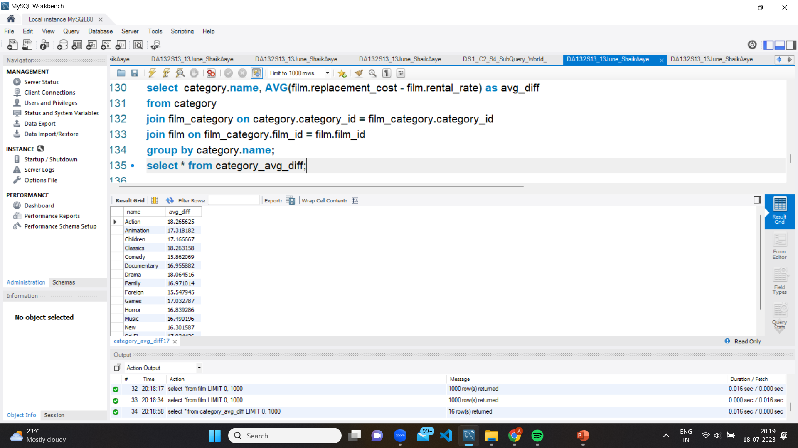
Output of TASK 11

Slide 36
Task 12 Display the names of categories and the number of movies per category sorted by number of movies
The Query " select category.name as Category_name,count(film_category.film_id)as Movie_count from category join film_category using(category_id) group by 1order by 2 desc “
STEP 1. `SELECT category.name AS Category_name, COUNT(film_category.film_id) AS Movie_count`: This line selects the `name` column from the `category` table and renames it as `Category_name`. It also counts the number of films in each category by counting the number of rows in the `film_category` table that have a matching `category_id`, and renames the count as `Movie_count`.
STEP 2. `FROM category JOIN film_category USING(category_id)`: This line specifies the two tables being used in the query and joins them using the `category_id` column.
STEP 3. `GROUP BY 1`: This line groups the result set by the first column (`Category_name`), which means that the count of movies will be calculated for each unique category.
STEP 4. `ORDER BY 2 DESC`: This line sorts the result set in descending order based on the second column (`Movie_count`), which means that the categories with the most movies will be listed first.
The query selects the category name and the number of movies in each category, groups the result by category name, and sorts the result in descending order based on the number of movies.

Slide 37

Output of TASK 12

Slide 38
ADVANTAGES
Improved decision-making
Increased profitability
Better audience engagement
Improved content quality
Competitive advantage

Slide 39
DISADVANTAGES
Limited scope
High cost
Time-consuming
Overreliance on data
Privacy concerns

Slide 40
APPLICATIONS
Audience analysis
Box office predictions
Script analysis
Talent identification
Marketing optimization

Slide 41
CONCLUSION
Important tool for studios and filmmakers in the film industry.
By analyzing data on audience behavior, feedback, and preferences, studios can make better decisions about which films to produce, how to market them, and how to improve their quality.
Data Analysis can help studios identify up coming talent, predict box office performance, and optimize their marketing strategies and distribution channels.

Slide 42
THANK YOU

